Slide 1


Namal Podcast
Presented By: Sadaqat Rasool
NIM-BSCS-2021-20

Slide 2
Outline
Introduction
Functional Requirements
Non-functional Requirements
User Characteristics
Data Flow Diagram (DFD’s)
Use Case Diagram
System Sequence Diagram
Activity Diagram
Test Cases
Deployment
Conclusion

Slide 3

Introduction
Enhancing learning with engaging live video interactions.
Features:
Live video sessions
Real-time interaction
Session archiving
Event announcements

Slide 4

Functional Requirements
User Authentication
Upcoming Event Announcements
Host Live Video Session
Audience Video Access and Interaction
Archiving Recorded Sessions

Slide 5

Non-Functional Requiremnts
Performance:
Real-Time Interaction
Timely Archiving
User Engagement
Availability:
Minimize downtime
Efficient media processing
Scalability:
Accommodating user and content growth

Slide 6

User Characteristics
Namal Community
Authenticates using Namal University email credentials.
Guests and Speakers
Receives unique access credentials for secure registration.
Podcast Hosts
Initiates and schedules dynamic live video sessions
Manages event details and fosters audience interaction
General Audience
Attends live sessions with real-time interaction features
Explores recently concluded videos and views upcoming events

Slide 7
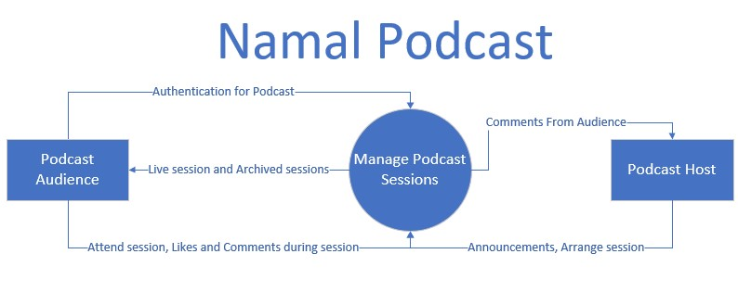
DFD Level 0:

Slide 8
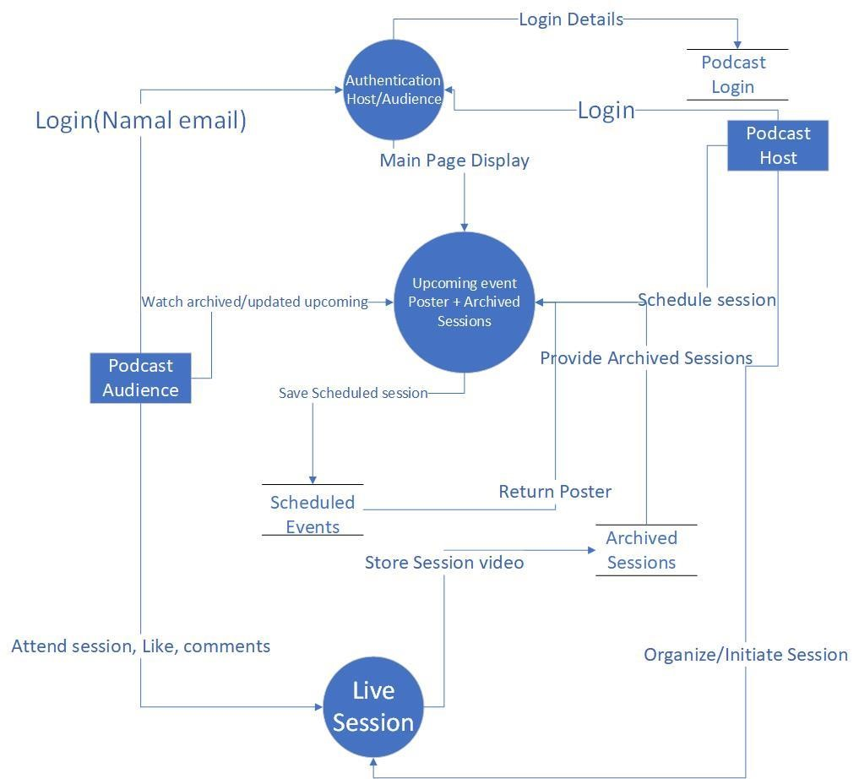
DFD Level 1:

Slide 9
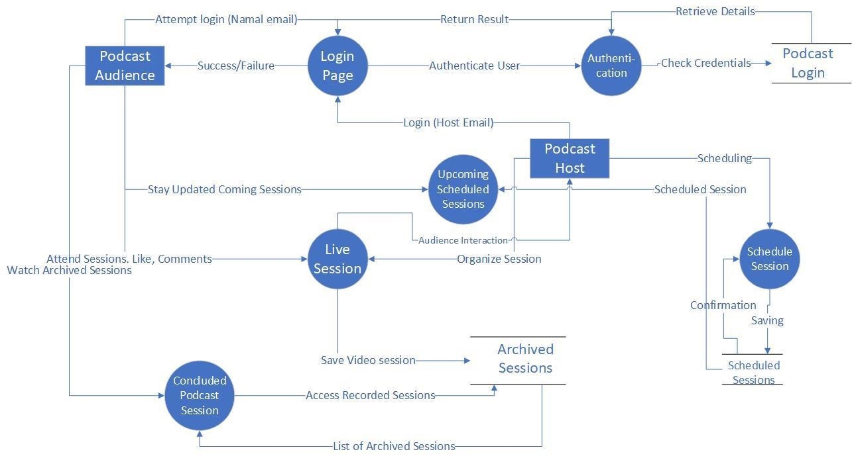
DFD Level 2:

Slide 10
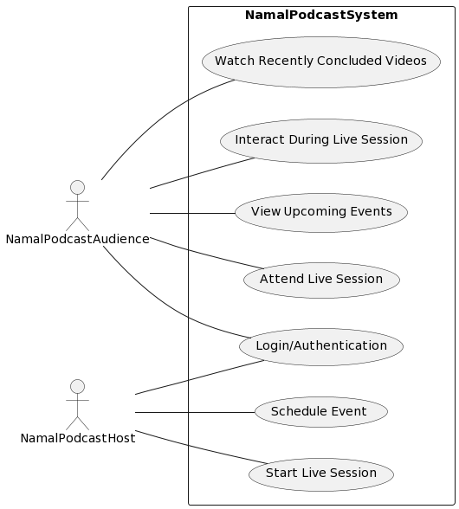
Use Case Diagram

Slide 11
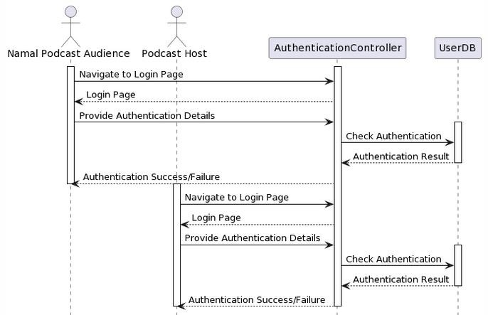
SSD for Authentication

Slide 12
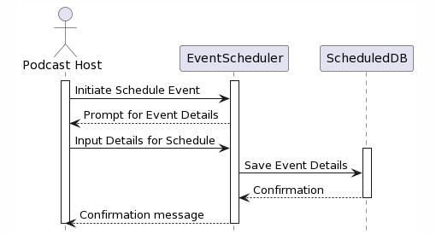
SSD for Schedule Event

Slide 13
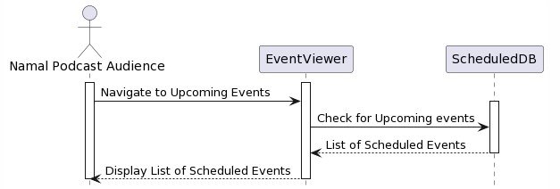
SSD for Upcoming Events

Slide 14
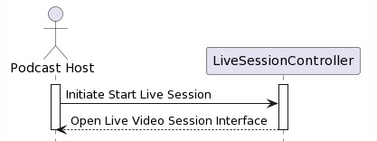
SSD for Start Live Session

Slide 15
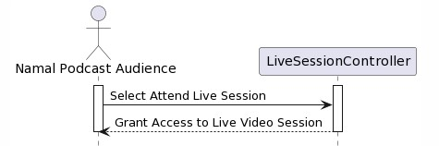
SSD for Attend Live Session

Slide 16
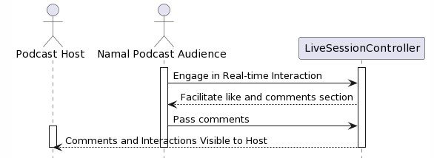
SSD for Interaction during session

Slide 17
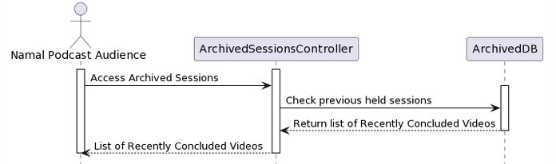
SSD for Archived Session

Slide 18
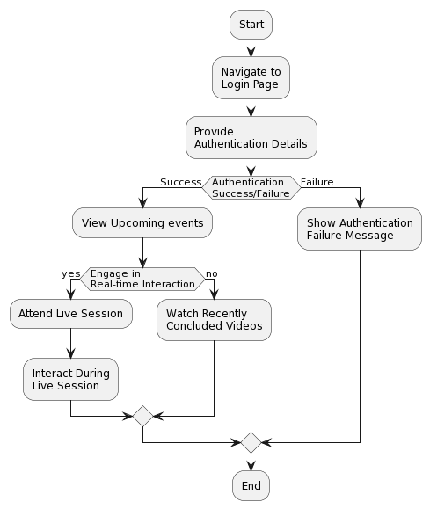
Activity Diagram

Slide 19
Test Case:
Test Case: User Authentication
Test Steps:
Host and Audience navigate to Login page.
Expected Result:
Audience and Host should be successfully authenticated through specified email.
Alternative:
If authentication fails, the system should prompt the user to re-enter valid credentials.
Host (special) and Audience (Namal email) enter valid Credentials.

Slide 20
Test Case: Archived Videos
Test Step:
Verify the Accessibility of recently concluded videos in the Archived Sessions.
Expected Result:
Podcast Audience try to get access Archived sessions.
Objective:
The system should present a list of recently concluded videos to watch.

Slide 21
Deployment
Pre-deployment:
Conduct final testing for live session features and interaction capabilities.
Deployment:
Release Namal Podcast to the production environment, minimizing downtime.
Post-deployment:
Monitor live session behavior and archiving functionalities for stability.

Slide 22

Conclusion:
Educational Impact:
Facilitates direct communication between students and educators.
Offers on-demand access to valuable educational content.
Enhanced Learning Environment:
Creates an engaging and dynamic platform for students.
Encourages active participation and collaborative learning.
Future Vision:
Commitment to continuous improvement based on user feedback.
Designed for future scalability to benefit a broader university audience.

Slide 23


